Slide 1
GE 103- Database Management
Lab#08
SQL

Slide 2
SQL queries
For each of the following, write an SQL query that
finds all courses that have more that 20 students.
finds all classes that have more students than there are seats in the room.
For each of the following, write at least two significantly different SQL queries that
finds all teachers giving more than one course.
finds all rooms that are used on Mondays.
finds the room with the highest number of seats.
lists all teachers along with their titles. Those without a title should be listed as having NULL.
finds the teacher(s) with the highest average number of students on his or her (their) courses.
Translate the following SQL queries to relational-algebraic expressions:
SELECT C.name, teacher
FROM Courses C, Teachers T
WHERE teacher = T.name;
SELECT day, COUNT(DISTINCT teacher)
FROM Courses C, Classes S
WHERE C.name = S.course
GROUP BY day;

Slide 3
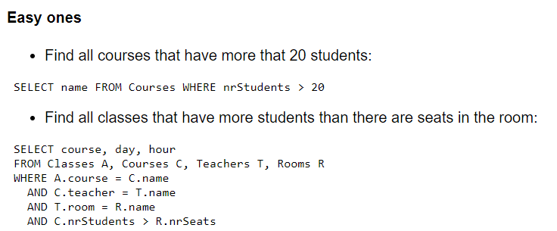

Slide 4
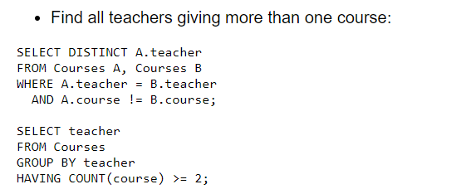

Slide 5
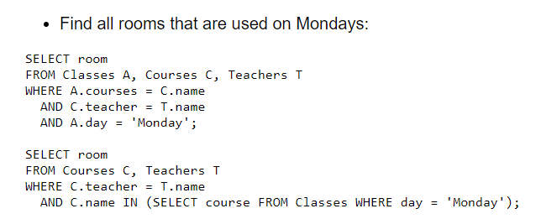

Slide 8
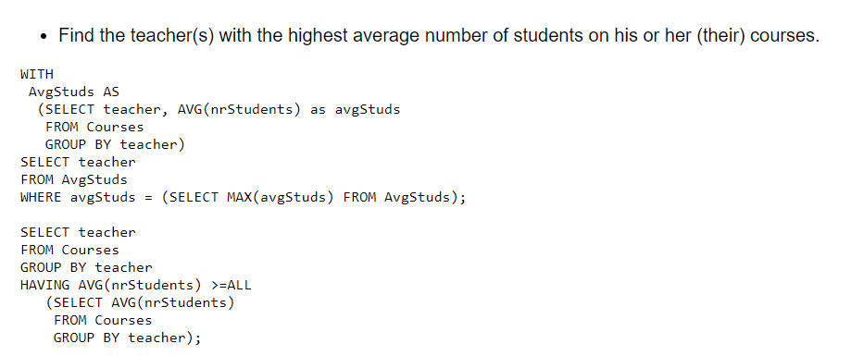

Slide 9
