Slide 1
GE 103- Database Management
Lab#01
E/R Diagrams

Slide 2
In this exercise we will practise modelling domains through the use of E-R diagrams. Your task is to create a database for scheduling classes.
The following attributes should be represented in your tables:
Course names
Teacher names
Teacher titles (optional, e.g. Professor)
Class room names
Number of students taking a course
Day and time of classes
Classes in a particular course are given at the same day and time each week, possibly more than once each week. A teacher can hold several courses, but will only hold classes in the same class room. More than one teacher could have classes in the same class room (though of course not at the same time).
Draw an E-R diagram modelling this domain.

Slide 3
Translating E-R diagrams to relations
Translate your E-R diagram to a database schema consisting of relations. Mark all keys and references that exist in and between your relations.
Do your relations suffer from any of the following?
Redundancy
Update anomalies
Deletion anomalies
Unconnected components
If yes, why, and can you fix it?

Slide 4
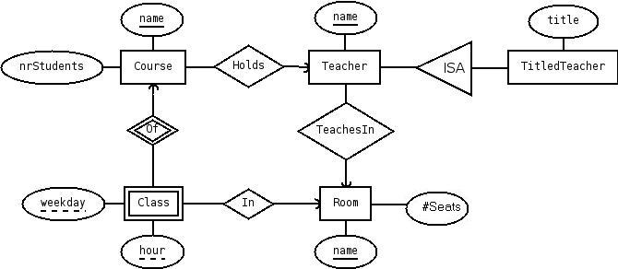

Slide 5
The question doesn't say whether each course is taught by one teacher, or whether more than one teacher can teach on a course.
Your solution will depend on the assumptions that you make. This diagram assumes that each course is taught by one teacher. One of the relationships shown in the diagram is redundant (which one?), so could be removed.
If we assume that more than one teacher can teach on a course, then the diagram would be different.
The subclassing could be discussed, since it means that a teacher can only have at most one title (e.g. Professor).
If one wanted the possibility to have more than one title for teachers, TitledTeacher should be replaced by an entity Title with a single key attribute title, and a many-to-many relationship to replace the ISA.

Slide 6
Transation to relations
Translating the E-R diagram except for the specialisation gives:
Rooms(name, nrSeats)
Teachers(name, room) room → Rooms.name
Courses(name, nrStudents, teacher) teacher → Teachers.name
Classes(course, weekday, hour, room) course → Courses.name room → Rooms.name
For the specialisation we can choose one of three different approaches. Suppose we choose the E-R approach, which means we get an extra relation that looks like
TitledTeachers(teacher, title) teacher → Teachers.name
This solution suffers from redundancy since given a course, a weekday and an hour, it is possible to find two occurences of rooms, one directly in Classes and one going via joins with Courses and Teachers, and we have no guarantees that these two will be the same.

